Slide 1
Announcements
Starting today, my office hours in 779 Soda will be:
3:15 - 4:05 on Mondays.
4:10 - 5:00 on Wednesdays.
Today I have to leave at 3:00 PM exactly, sorry, can’t take questions after, but drop by at 4:10!
Come talk about anything.
Top priority: Conceptual / theoretical material related to 61B.
Bottom priority: Specific homework, lab, or project questions. Debugging.
Middle priority: Anything else (life questions, grad school, chatting about recent news, in office-hours arm wrestling tournament, whatever).

Slide 2
Reminder: addLast (with Sentinel Node)
Bottom line: Having a sentinel simplifies our addLast method.
No need for a special case to check if sentinel is null (since it is never null).
public void addLast(int x) {
size += 1;
if (sentinel == null) {
sentinel = new IntNode(x, null);
return;
}
IntNode p = sentinel;
while (p.next != null) {
p = p.next;
}
p.next = new IntNode(x, null);
}
addFirst()
size
sentinel
getFirst()
0
addLast()
size()
??
item
next
Notes:
Didn’t have this slide when I did the lecture oops.

Slide 3
Note on Invariants
An invariant is a condition that is guaranteed to be true during code execution (assuming there are no bugs in your code).
An SLList with a sentinel node has at least the following invariants:
The sentinel reference always points to a sentinel node.
The first node (if it exists), is always at sentinel.next.
The size variable is always the total number of items that have been added.
Invariants make it easier to reason about code:
Can assume they are true to simplify code (e.g. addLast doesn’t need to worry about nulls).
All methods should be written assuming the first real value is in sentinel.next.
Must ensure that methods preserve invariants.

Slide 4

CS61B, 2022
Lecture 6: DLLs and Arrays
Doubly Linked Lists
Generic SLLists
Arrays
Arrays vs. Classes
Notes:
38 minutes left

Slide 5
Doubly Linked Lists
(In Brief)

Slide 6
Summary of Last Time (From IntList to SLList)
Methods | Non-Obvious Improvements
addFirst(int x) | #1 | Rebranding: IntList → IntNode
getFirst() | #2 | Bureaucracy: SLList
addLast(int x) | #3 | Access Control: public → private
size() | #4 | Nested Class: Bringing IntNode into SLList
 | #5 | Caching: Saving size as an int.
 | #6 | Generalizing: Adding a sentinel node to allow representation of the empty list.
addFirst()
size
sentinel
getFirst()
3
addLast()
size()
63
5
10
15
item
next

Slide 7
One Downside of SLLists
Inserting at the back of an SLList is much slower than the front.
public void addLast(int x) {
size += 1;
IntNode p = sentinel;
while (p.next != null) {
p = p.next;
}
p.next = new IntNode(x, null);
}
public void addFirst(int x) {
sentinel.next =
new IntNode(x, sentinel.next);
}

Slide 8
Improvement #7: (???) Goal: Fast addLast
How could we modify our list data structure so that addLast is also fast?
addFirst()
size
sentinel
getFirst()
3
addLast()
size()
??
3
9
50
item
next

Slide 9
Is .last enough? http://yellkey.com/ever
Suppose we want to support add, get, and remove operations for both ends, will having a last pointer result for fast operations on long lists?
Yes
No, add would be slow.
No, get would be slow.
No, remove would be slow.
addLast()
size
sentinel
last
getLast()
3
removeLast()
size()
??
3
9
50
item
next
Notes:
Question answered by 3:24 during Spring 2017

Slide 10
.last Is Not Enough
Suppose we want to support add, get, and remove operations, will having a last pointer result for fast operations on long lists?
No, remove would be slow.
RemoveLast requires setting 9’s next pointer to null, and point last at the 9 node.
Have to search through list to find the 9 node (second to last).
addLast()
size
sentinel
last
getLast()
3
removeLast()
size()
??
3
9
50
item
next
i.e. slow because we have to find the “9” node.

Slide 11
Improvement #7: .last and ??? Goal: Fast operations on last.
We added .last. What other changes might we make so that remove is also fast?
addLast()
size
sentinel
last
getLast()
3
removeLast()
size()
??
3
9
50
item
next

Slide 12
Improvement #7: .last and .prev
We added .last. What other changes might we make so that remove is also fast?
Add backwards links from every node.
This yields a “doubly linked list” or DLList, as opposed to our earlier “singly linked list” or SLList.
Note: Arrows point at entire nodes, not fields!
Example: last holds the address of the last node, not the item field of the sentinel node.
addLast()
size
sentinel
last
getLast()
2
removeLast()
size()
??
3
9
prev
item
next
prev
item
next
prev
item
next

Slide 13
Doubly Linked Lists (Naive)
Reverse pointers allow all operations (add, get, remove) to be fast.
We call such a list a “doubly linked list” or DLList.
addLast()
size
sentinel
last
getLast()
0
removeLast()
size()
??
addLast()
size
sentinel
last
getLast()
2
removeLast()
size()
??
3
9
prev
item
next
prev
item
next
prev
item
next

Slide 14
Doubly Linked Lists (Naive)
Non-obvious fact: This approach has an annoying special case: last sometimes points at the sentinel, and sometimes points at a ‘real’ node.
addLast()
size
sentinel
last
getLast()
0
removeLast()
size()
??
addLast()
size
sentinel
last
getLast()
2
removeLast()
size()
??
3
9
prev
item
next
prev
item
next
prev
item
next

Slide 15
Doubly Linked Lists (Double Sentinel)
One solution: Have two sentinels.
addLast()
size
sentFront
sentBack
getBack()
0
removeLast()
size()
??
??
addLast()
size
sentFront
sentBack
getBack()
2
removeLast()
size()
??
3
9
??
prev
item
next
This is one reasonable approach for Project 1.

Slide 16
Doubly Linked Lists (Circular Sentinel)
Even better topology (IMO):
Note: arrows are pointing at entire nodes, not specific fields of nodes.
addLast()
size
sentinel
getLast()
0
removeLast()
size()
??
Examples:
sentinel.next.next is the node with item=9.
sentinel.next.next.next points at the sentinel node.
The arrow in magenta is sentinel.next.next.next
addLast()
size
sentinel
getLast()
2
removeLast()
size()
This is my preferred approach for Project 1.
??
3
9
prev
item
next

Slide 17
Improvement #8: Fancier Sentinel Node(s)
While fast, adding .last and .prev introduces lots of special cases.
To avoid these, either:
Add an additional sentBack sentinel at the end of the list.
Make your linked list circular (highly recommened for project 1), with a single sentinel in the middle.

Slide 18
DLList Summary
Methods | Non-Obvious Improvements
addFirst(int x) | #1 | Rebranding: IntList → IntNode
getFirst() | #2 | Bureaucracy: SLList
size() | #3 | Access Control: public → private
addLast(int x) | #4 | Nested Class: Bringing IntNode into SLList
removeLast() | #5 | Caching: Saving size as an int.
 | #6 | Generalizing: Adding a sentinel node to allow representation of the empty list.
 | #7 | Looking back:.last and .prev allow fast removeLast
 | #8 | Sentinel upgrade: Avoiding special cases with sentBack or circular list.
Still many steps before we have an industrial strength data structure. Will discuss over coming weeks.

Slide 19
Generic Lists

Slide 20
Integer Only Lists
One issue with our list classes: They only supports integers.
public class SLList { private IntNode sentinel;
private int size;
public class IntNode {
public int item; public IntNode next; ... }
... }
SLList s1 = new SLList(5);
s1.addFirst(10);
Works fine!
SLList s2 = new SLList("hi");
s2.addFirst("apple");
SLListLauncher.java:6: error: incompatible types: String cannot be converted to int
SLList d2 = new SLList("hi");

Slide 21
SLists
Java allows us to defer type selection until declaration.
public class SLList<BleepBlorp> { private IntNode sentinel;
private int size;
public class IntNode {
public BleepBlorp item; public IntNode next; ... }
... }
SLList<Integer> s1 = new SLList<>(5);
s1.insertFront(10);
SLList<String> s2 = new SLList<>("hi");
s2.insertFront("apple");

Slide 22
Generics
We’ll spend a lot more time with generics later, but here are the rules of thumb you’ll need for project 1:
In the .java file implementing your data structure, specify your “generic type” only once at the very top of the file.
In .java files that use your data structure, specify desired type once:
Write out desired type during declaration.
Use the empty diamond operator <> during instantiation.
When declaring or instantiating your data structure, use the reference type.
int: Integer
double: Double
char: Character
boolean: Boolean
long: Long
etc.
DLList<Double> s1 = new DLList<>(5.3);
double x = 9.3 + 15.2;
s1.insertFront(x);

Slide 23
Arrays

Slide 24
Our Long Term Goal (next two lectures): The AList
In the last few lectures, we’ve seen how we can harness a recursive class definition to build an expandable list, ie. the IntList, the SLList, and the DLList.
In the next two, we’ll see how we can harness arrays to build such a list.

Slide 25
Getting Memory Boxes
To store information, we need memory boxes, which we can get in Java by declaring variables or instantiating objects. Examples:
int x;
Walrus w1;
Walrus w2 = new Walrus(30, 5.6);
Arrays are a special kind of object which consists of a numbered sequence of memory boxes.
To get ith item of array A, use A[i].
Unlike class instances which have have named memory boxes.
Gives us a memory box of 32 bits that stores ints.
Gives us a memory box of 64 bits that stores Walrus references.
Gives us a memory box of 64 bits that stores Walrus references, and also gives us 96 bits for storing the int size (32 bits) and double tuskSize (64 bits) of our Walrus.

Slide 26
Arrays
Arrays consist of:
A fixed integer length (cannot change!)
A sequence of N memory boxes where N=length, such that:
All of the boxes hold the same type of value (and have same # of bits).
The boxes are numbered 0 through length-1.
Like instances of classes:
You get one reference when its created.
If you reassign all variables containing that reference, you can never get the array back.
Unlike classes, arrays do not have methods.
Notes:
Note: Mention of things getting garbage collected weakens the narrative a bit, but I think it’s a good reinforcement of a tricky idea.

Slide 27
Arrays
Like classes, arrays are (almost always) instantiated with new.
Three valid notations:
x = new int[3];
y = new int[]{1, 2, 3, 4, 5};
int[] z = {9, 10, 11, 12, 13};
All three notations create an array, which we saw on the last slide comprises:
A length field.
A sequence of N boxes, where N = length.
Creates array containing 3 int boxes (32 x 3 = 96 bits total). Each container gets a default value.
Can omit the new if you are also declaring a variable.
As an aside: In Oracle’s implementation of Java, all Java objects also have some overhead. Total size of an array=192 + KN bits, where K is the number of bits per item (Sedgewick/Wayne pg. 201 for more)

Slide 28
Array Basics: http://goo.gl/tFyMEJ
int[] z = null;
int[] x, y;
x = new int[]{1, 2, 3, 4, 5};
y = x;
x = new int[]{-1, 2, 5, 4, 99};
y = new int[3];
z = new int[0];
int xL = x.length;
String[] s = new String[6];
s[4] = "ketchup";
s[x[3] - x[1]] = "muffins";
int[] b = {9, 10, 11};
System.arraycopy(b, 0, x, 3, 2);
Notes:
Do in Java visualizer, better arrow notation except for with String.

Slide 29
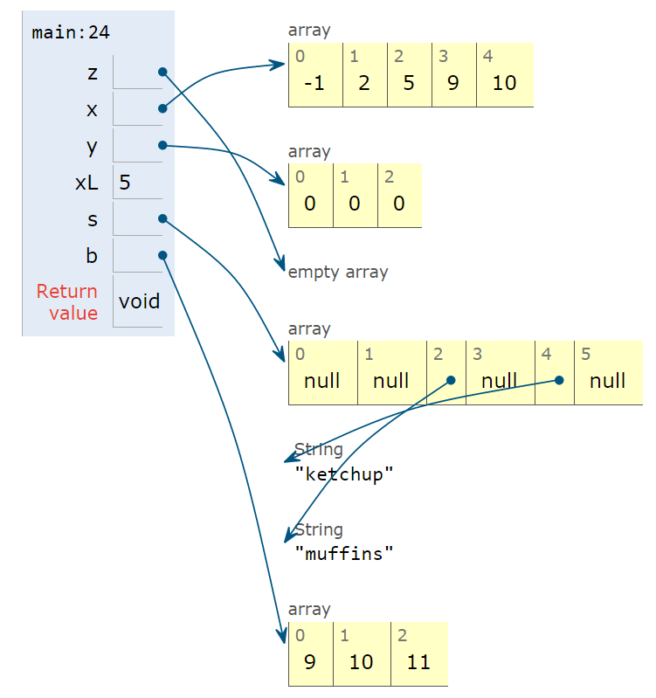
Array Basics: https://goo.gl/gzAuBa
int[] z = null;
int[] x, y;
x = new int[]{1, 2, 3, 4, 5};
y = x;
x = new int[]{-1, 2, 5, 4, 99};
y = new int[3];
z = new int[0];
int xL = x.length;
String[] s = new String[6];
s[4] = "ketchup";
s[x[3] - x[1]] = "muffins";
int[] b = {9, 10, 11};
System.arraycopy(b, 0, x, 3, 2);
Notes:
Do in Java visualizer, better arrow notation except for with String.

Slide 30
Arraycopy
Two ways to copy arrays:
Item by item using a loop.
Using arraycopy. Takes 5 parameters:
Source array
Start position in source
Target array
Start position in target
Number to copy
arraycopy is (likely to be) faster, particularly for large arrays. More compact code.
Code is (arguably) harder to read.
System.arraycopy(b, 0, x, 3, 2);
(In Python): x[3:5] = b[0:2]

Slide 31
2D Arrays

Slide 32
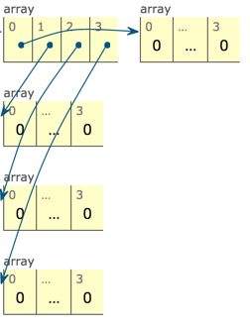
Arrays of Array Addresses (http://goo.gl/VS4cOK)
int[][] pascalsTriangle;
pascalsTriangle = new int[4][];
int[] rowZero = pascalsTriangle[0];
pascalsTriangle[0] = new int[]{1};
pascalsTriangle[1] = new int[]{1, 1};
pascalsTriangle[2] = new int[]{1, 2, 1};
pascalsTriangle[3] = new int[]{1, 3, 3, 1};
int[] rowTwo = pascalsTriangle[2];
rowTwo[1] = -5;
int[][] matrix;
matrix = new int[4][];
matrix = new int[4][4];
int[][] pascalAgain = new int[][]{{1}, {1, 1},
{1, 2, 1}, {1, 3, 3, 1}};
Syntax for arrays of arrays can be a bit confounding. You’ll learn through practice (much later).

Slide 33
Array Boxes Can Contain References to Arrays!
int[][] pascalsTriangle;
pascalsTriangle = new int[4][];
int[] rowZero = pascalsTriangle[0];
pascalsTriangle[0] = new int[]{1};
pascalsTriangle[1] = new int[]{1, 1};
pascalsTriangle[2] = new int[]{1, 2, 1};
pascalsTriangle[3] = new int[]{1, 3, 3, 1};
int[] rowTwo = pascalsTriangle[2];
rowTwo[1] = -5;
int[][] matrix;
matrix = new int[4][];
matrix = new int[4][4];
int[][] pascalAgain = new int[][]{{1}, {1, 1},
{1, 2, 1}, {1, 3, 3, 1}};
Array of int array references.
Create four boxes, each can store an int array reference
Create a new array with three boxes, storing integers 1, 2, 1, respectively. Store a reference to this array in pascalsTriangle box #2.
Creates 1 total array.
Creates 5 total arrays.
Syntax for arrays of arrays can be a bit confounding. You’ll learn through practice (much later).

Slide 34
What Does This Code Do? (Bonus Slides Only Exercise)
What will be the value of x[0][0] and w[0][0] when the code shown completes?
x: 1, w: 1
x: 1, w: -1
x: -1, w: 1
x: -1, w: -1
Other
int[][] x = {{1, 2, 3}, {4, 5, 6}, {7, 8, 9}};
int[][] z = new int[3][];
z[0] = x[0];
z[0][0] = -z[0][0];
int[][] w = new int[3][3];
System.arraycopy(x[0], 0, w[0], 0, 3);
w[0][0] = -w[0][0];
arraycopy parameters are:
Source array
Start position in source
Target array
Start position in target
Number to copy
Answer: https://goo.gl/CqrZ7Y
Notes:
This question is a little boring.

Slide 35
Arrays vs. Classes (Bonus Video in Fa 2022)

Slide 36
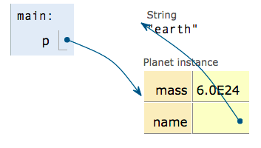

Arrays vs. Classes
Arrays and Classes can both be used to organize a bunch of memory boxes.
Array boxes are accessed using [] notation.
Class boxes are accessed using dot notation.
Array boxes must all be of the same type.
Class boxes may be of different types.
Both have a fixed number of boxes.
public class Planet {
public double mass;
public String name;
...
}
int[] x = new int[]{100, 101, 102, 103};
Planet p = new Planet(6e24, "earth");

Slide 37
Arrays vs. Classes
Array indices can be computed at runtime.
int[] x = new int[]{100, 101, 102, 103};
int indexOfInterest = askUser();
int k = x[indexOfInterest];
System.out.println(k);
jug ~/Dropbox/61b/lec/lists3
$ javac ArrayDemo.java
$ java ArrayDemo
What index do you want? 2
102

Slide 38
Arrays vs. Classes
Class member variable names CANNOT be computed and used at runtime.
String fieldOfInterest = "mass";
Planet earth = new Planet(6e24, "earth");
double mass = earth[fieldOfInterest];
System.out.println(mass);
jug ~/Dropbox/61b/lec/lists3
$ javac ClassDemo.java
ClassDemo.java:5: error: array required,
but Planet found.
double mass = earth[fieldOfInterest]; ^
… if you reallllly want to do this, you can: https://goo.gl/JxpyLq
Notes:
http://cscircles.cemc.uwaterloo.ca/java_visualize/#code=public+class+ClassNameHere+%7B%0A+++public+static+class+Planet+%7B%0A++++++public+double+mass%3B%0A++++++public+String+name%3B%0A+++++++++%0A++++++public+Planet(double+m,+String+n)+%7B%0A+++++++++mass+%3D+m%3B%0A+++++++++name+%3D+n%3B%0A++++++%7D%0A+++%7D%0A++++++%0A+++public+static+void+main(String%5B%5D+args)+%7B%0A++++++Planet+p+%3D+new+Planet(6e24,+%22earth%22)%3B%0A++++++int%5B%5D+x+%3D+new+int%5B%5D%7B100,+101,+102,+103%7D%3B%0A%0A++++++int+indexOfInterest+%3D+2%3B%0A++++++String+fieldOfInterest+%3D+%22mass%22%3B%0A%0A++++++/*+get+contents+of+container+%232+*/%0A++++++int+k+%3D+x%5BindexOfInterest%5D%3B%0A+++%7D%0A%7D&mode=edit

Slide 39
Arrays vs. Classes
Class member variable names CANNOT be computed and used at runtime.
Dot notation doesn’t work either.
String fieldOfInterest = "mass";
Planet earth = new Planet(6e24, "earth");
double mass = earth.fieldOfInterest;
System.out.println(mass);
jug ~/Dropbox/61b/lec/lists3
$ javac ClassDemo.java
ClassDemo.java:5: error: cannot find Symbol
double mass = earth.fieldOfInterest; ^
symbol: variable fieldOfInterest
location: variable earth of type Planet
… if you reallllly want to do this, you can: https://goo.gl/JxpyLq
Notes:
http://cscircles.cemc.uwaterloo.ca/java_visualize/#code=public+class+ClassNameHere+%7B%0A+++public+static+class+Planet+%7B%0A++++++public+double+mass%3B%0A++++++public+String+name%3B%0A+++++++++%0A++++++public+Planet(double+m,+String+n)+%7B%0A+++++++++mass+%3D+m%3B%0A+++++++++name+%3D+n%3B%0A++++++%7D%0A+++%7D%0A++++++%0A+++public+static+void+main(String%5B%5D+args)+%7B%0A++++++Planet+p+%3D+new+Planet(6e24,+%22earth%22)%3B%0A++++++int%5B%5D+x+%3D+new+int%5B%5D%7B100,+101,+102,+103%7D%3B%0A%0A++++++int+indexOfInterest+%3D+2%3B%0A++++++String+fieldOfInterest+%3D+%22mass%22%3B%0A%0A++++++/*+get+contents+of+container+%232+*/%0A++++++int+k+%3D+x%5BindexOfInterest%5D%3B%0A+++%7D%0A%7D&mode=edit

Slide 40
Another view
The only (easy) way to access a member of a class is with hard-coded dot notation.
The Java compiler does not treat text on either side of a dot as an expression, and thus it is not evaluated.
See a compilers or programming languages class for more!
int k = x[indexOfInterest]; /* no problem */
double m = p.fieldOfInterest; /* won't work */
double z = p[fieldOfInterest]; /* won't work */
/* No (sane) way to use field of interest */
double w = p.mass; /* works fine */

Slide 42

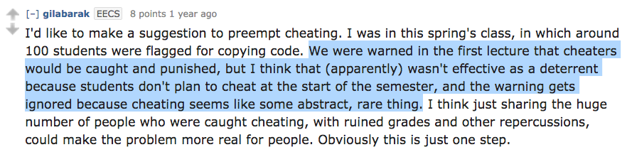
One Last Note on Plagiarism

Slide 43
Collaboration Policy
We have enumerated very specific rules whose violation will result in being reported to the office of student conduct:
By You Alone: All project code that you submit (other than skeleton code) should be written by you (or your partner) alone, except for small snippets that solve tiny subproblems (examples in collaboration policy online).
Do Not Possess or Share Code: Before a project deadline, you should never be in possession of solution code that you did not write (on paper, electronically, etc.). You are equally culpable if you share. DO NOT GIVE YOUR CODE TO ANYONE, EVEN IF THEY ARE DESPERATE. Also, don’t post on GitHub publicly!
Cite Your Sources: When you receive significant assistance from someone else (with ideas, debugging, code-snippets from stack overflow etc.), you should cite that help somewhere in your source code as a comment that includes “@source”. You will not be penalized for receiving this help.

Slide 44
Permissible But with Extreme Caution
Helping someone debug (don’t touch their keyboard/mouse/other).
Looking at someone else’s code to help them.
Extra Dangerous: Looking at someone else’s code to understand something. If you do this, don’t write code anytime soon after looking at that code, your solution is going to gravitate straight to theirs.
Ultra Danger: Working on a project alongside another person or group of people. Your code should not substantially resemble anyone else's!
Were it enforceable, I’d say no looking at other students’ code at all, but I want you to take these rules seriously (unlike, say, speed limits).
The effect should be as if you’d never seen anyone’s else code at all.

Slide 45

Plagiarism will (Probably) be Detected, and Dealt with Harshly
Plagiarism detection software is very sophisticated.
Also easy to use!
Every semester we send 50-100 cases to the Office of Student Conduct.
For some reason people don’t believe me. From 2017 incident reports: “To be honest, when Professor Hug said there is a way to detect plagiarism, I did not believe it. I believed there is no way to detect code similarity. I mean, how is that even possible.”
Please contact us if 61B is causing massive disruptions to your life. We are willing to give more slip days and can be flexible to accommodate you.
Notes:
6 minutes

